Slide 1
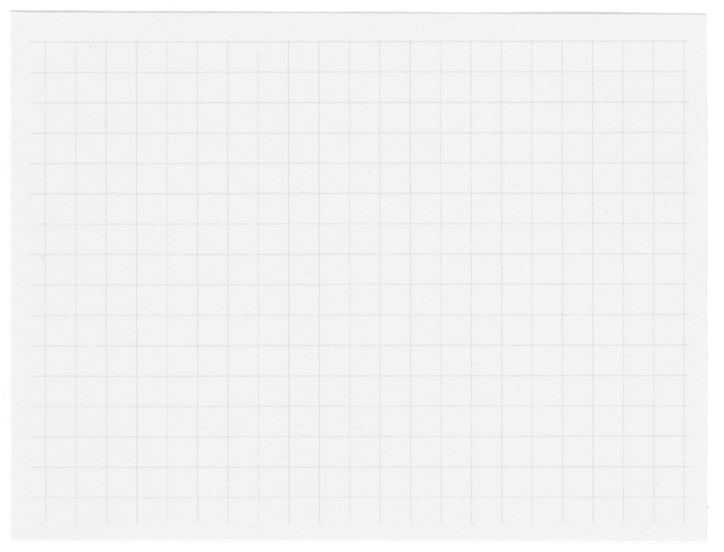

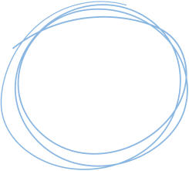

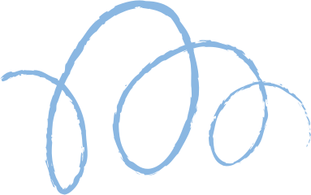









Heart Disease Prediction Project
By Laurine Owino and Lydiah Florence Njeri

Slide 2

Project Overview
Objective: Perform supervised and unsupervised learning (predict the presence of heart disease).
Dataset Details:
Features: Age, Sex, Cholesterol, Blood Pressure, Chest Pain type, EKG results, etc.
Target: Binary classification (Heart Disease Presence: Yes/No).
Key Steps:
Data Preprocessing.
Training Supervised Learning Model
Training Unsupervised Learning Model
Dataset: Heart Disease Prediction dataset.

Slide 3
Scaling
StandardScaler for standardization (mean = 0, SD = 1).
MinMaxScaler for normalization (range: [0, 1])
Plot the data using a boxplot to visualize the transformed data.
02.
Data Pre-Processing
Encoding & Removing Outliers
Converted target variable values ("Presence" and "Absence") to numeric values (1, 0) for compatibility with our ML models.
Used Isolation Forest to remove identified outliers - handles high dimension mixed data types well
03.
Data Exploration
Checked data for null and duplicate values, but none were in our dataset.
Visualized the data in a boxplot & histogram to interpret and understand the distribution of our data.
Outlier detection using isolation forest
01.
Feature Engineering
Used PCA to reduce the dimensionality of our data from 13 variables to two components.
We have represented 36.1% of the variance in our dataset in a 2D space.
04.

Slide 4
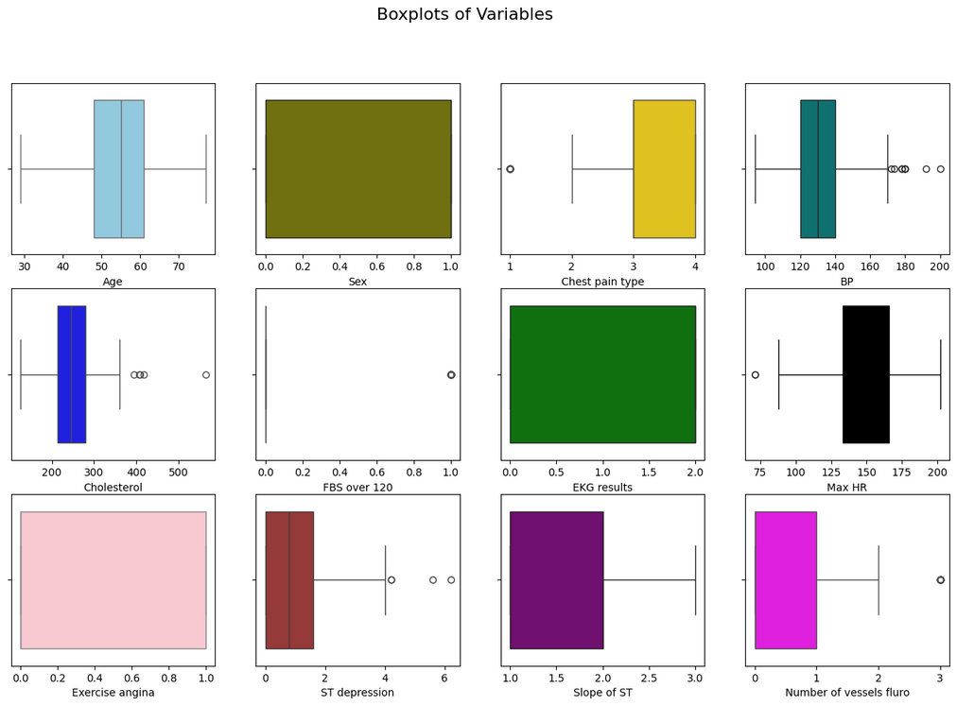
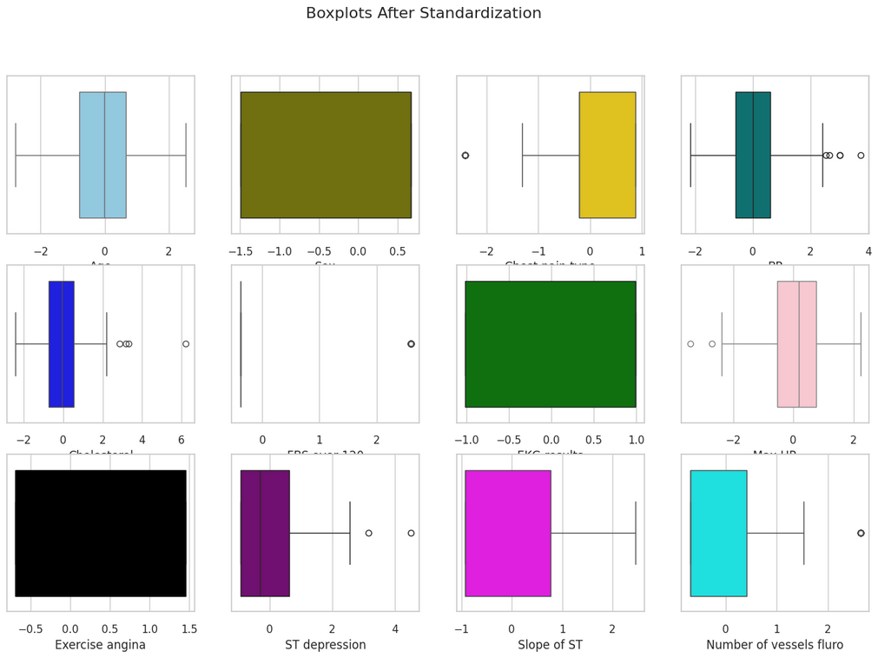
Boxplot before and after removing outliers and standardization
BEFORE
AFTER
Observation:
Scaling and standardizing brought all features to similar ranges, while data normalization made outliers less influential. As a result, our models will converge faster, with reduced impact from outliers.

Slide 5
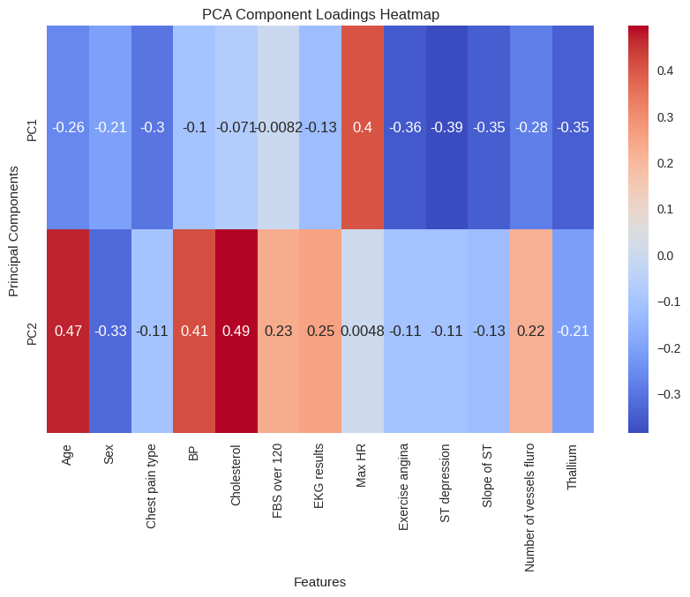
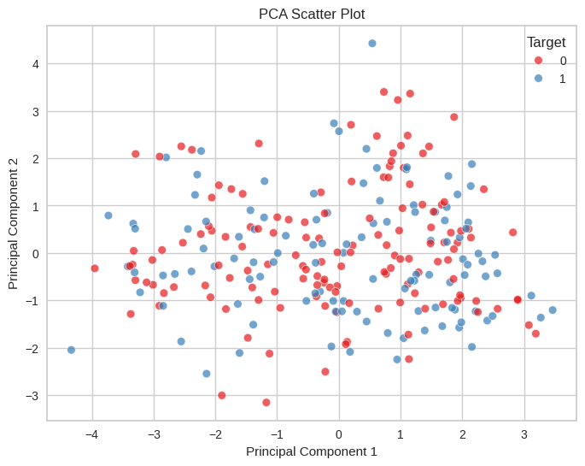
PCA and heatmap
HEATMAP
PCA SCATTERPLOT
Observation:
PCA reduced the dataset from 13 variables to 2 principal components (PC1 and PC2), capturing 36.1% of the variance. This indicates that a significant amount of variance is lost when visualizing in 2D.

Slide 6
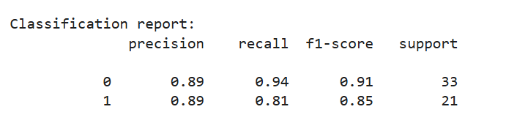
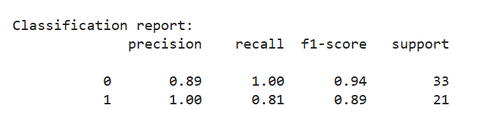
SUPERVISED LEARNING WITH SVM STEPS
01
02
03
04
Split data into training and testing sets (80% training, 20% testing).
Standardizing the data using StandardScaler()
Train the model on the 80% training data using linear SVM.
Run predictions on the trained model using the 20% test set.
Evaluate the linear SVM model using the confusion matrix to get the output below:
Calculate the ROC-AUC score for the linear SVM, which is 0.87.
Hyperparameter optimization with Grid Search and cross-validation
Calculate the ROC-AUC score for the best model, which is now 0.90.
The best SVM model performance is shown below, which shows a slight improvement in recall, precision, and f1-score.

Slide 7
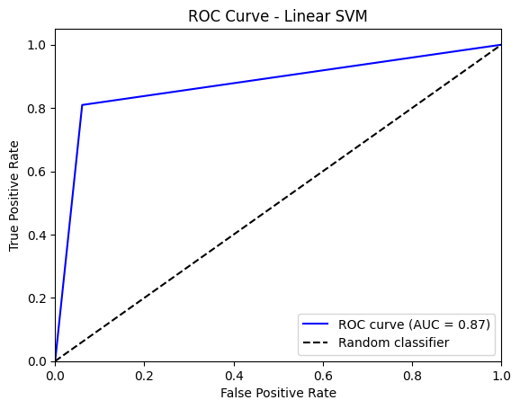
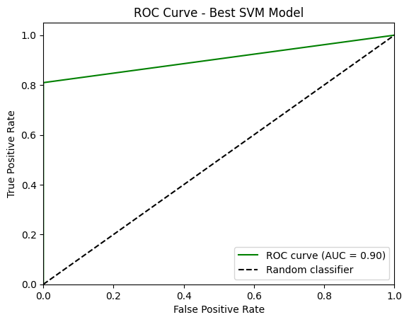
SVM ROC-AUC CURVE
Linear SVM
Linear SVM - Best Model
Observation
The baseline SVM with a linear kernel provided moderate accuracy but struggled with non-linear relationships. The optimized SVM model with an RBF kernel and tuned hyperparameters significantly improved accuracy and balanced precision and recall.

Slide 8
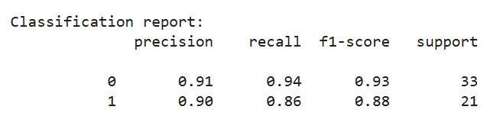
SUPERVISED LEARNING WITH LOGISTIC REGRESSION STEPS
01
02
03
04
Split data into training and testing sets (80% training, 20% testing).
Standardize the data using StandardScaler()
Traine the model on the 80% training data using Logistic Regression.
Check for multicollinearity.
Analyzing the correlation between explanatory variables .
Check for the linear relationship between the variables and logit.
Calculate the ROC-AUC score for the linear SVM which is 0.91 and print the model's classification report as shown below.

Slide 9
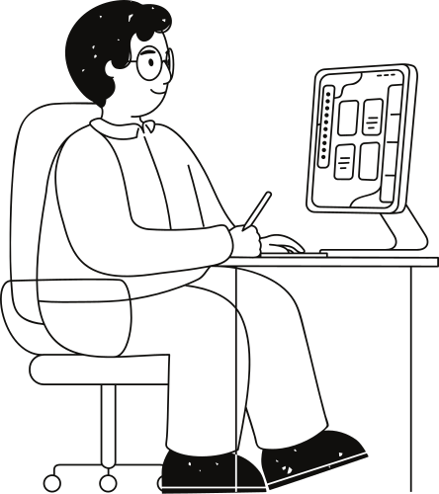
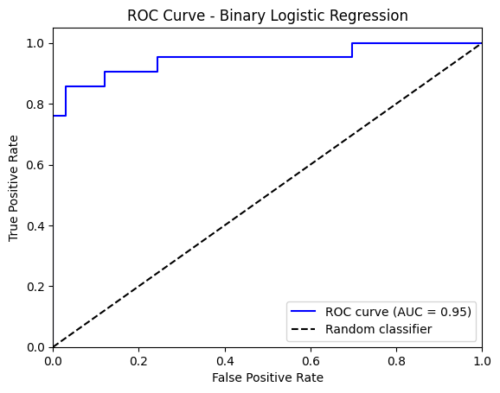
Logistic Regression ROC-AUC Curve

Slide 10
Supervised Learning Conclusion
Best Model: Logistic Regression
Performance Metrics
Logistic regression achieved higher precision, recall, and F1-score compared to the best SVM model.
ROC-AUC Curve
Logistic Regression's ROC-AUC score was higher, indicating it distinguishes between the presence and absence of heart disease more effectively than the best SVM model.
Its ROC curve is also closer to the top-left corner, reflecting better performance compared to SVM.

Slide 11
Dimension Reduction
Using PCA, Dimension of the data was reduced to 2 which constituted about 41% of the data
Unsupervised Machine Learning
Clustering with K-means
Data was clustered into 2 classes; the choice informed by the Silhouette score and Elbow method
Clustering with Hierachical Clustering
Data was classified into 2 clusters; choice informed by the dendogram.
Gower’s distance used because of the mix of categorical and continuous data

Slide 12
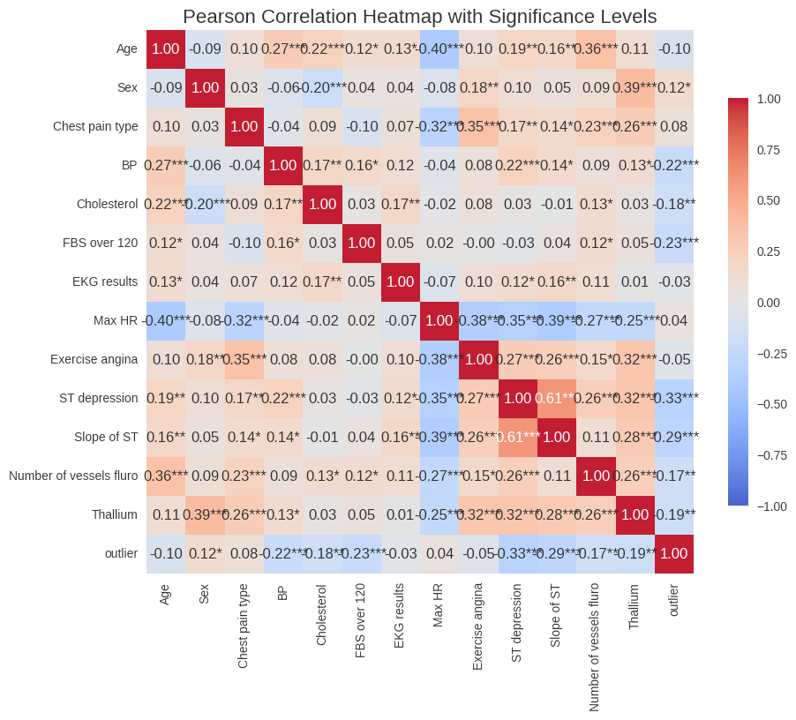
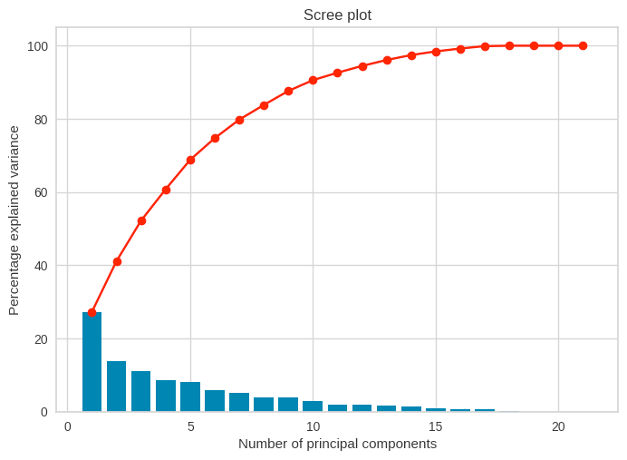
Dimension Reduction (PCA)
Pearson correlation matrix with Heatmap
Informs the decision to reduce the dimensions
Scree Plot
Shows information retained by keeping the different number of PCs

Slide 13
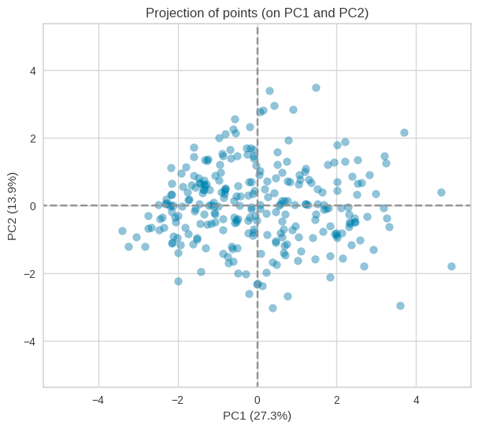
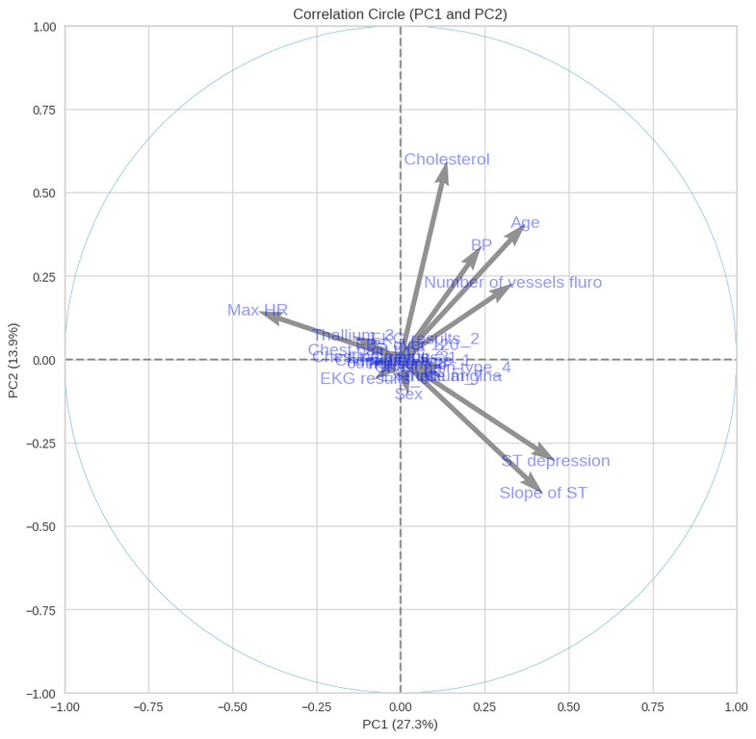
Dimension Reduction (Results)
The data points are projected on 2D with PC1 and PC2
The 2 data planes don’t give a lot of information on any of the original features (the arrows not close to the circle)
About 36.1% of the variance is explained by the components

Slide 14
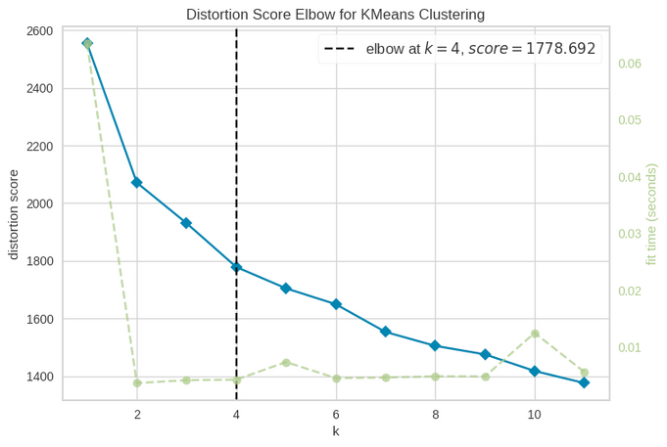
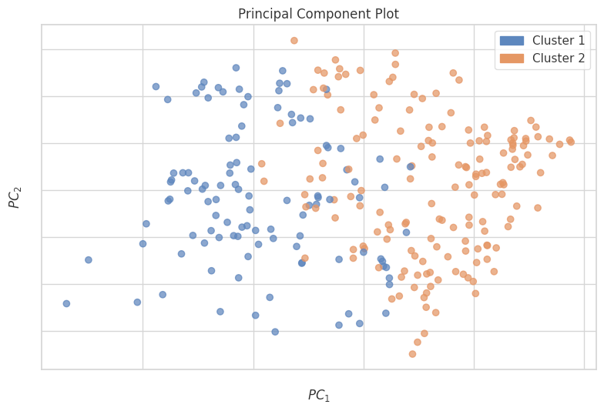
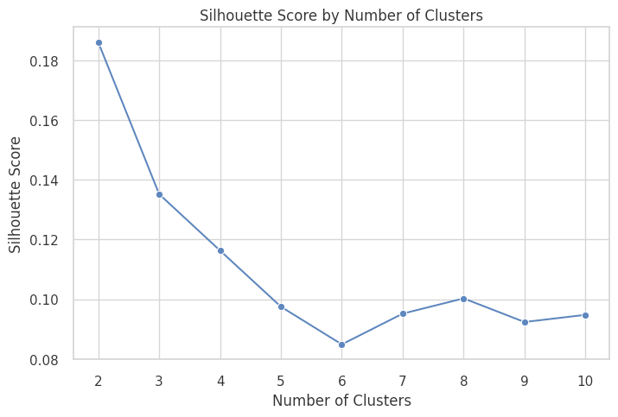
K-Means (with full data)
K is chosen to be 2, which has the highest silhouette score of 0.18 and seems to have an elbow.

Slide 15
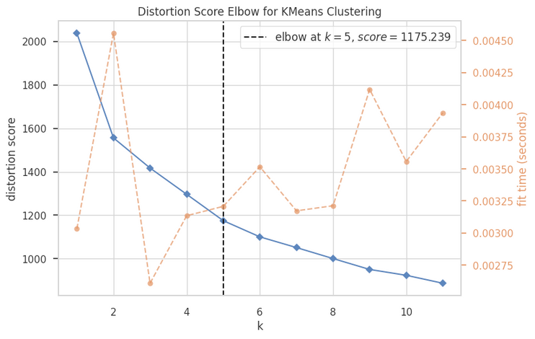
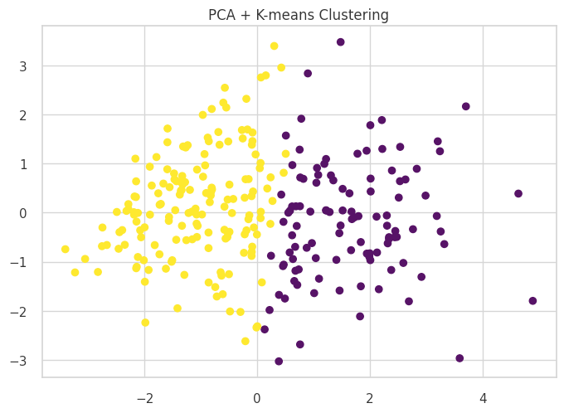
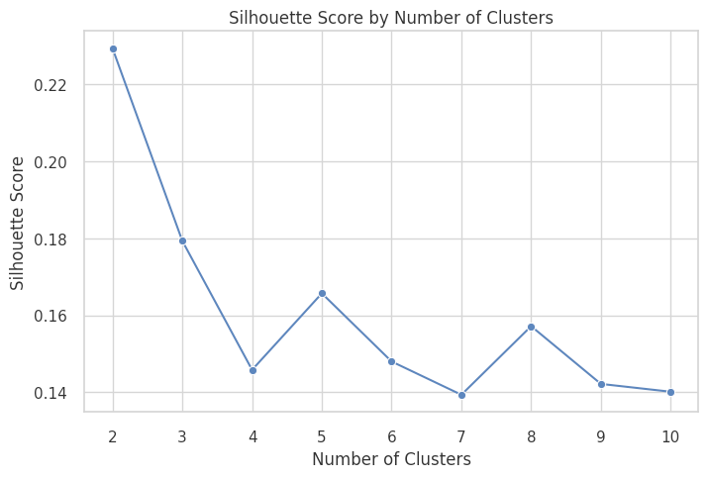
K-Means (with 7 PCs)
K-means is done on PCA with 7 components (about 80% of the data.
K is chosen to be 2, which has the highest silhouette score of 0.22 and seems to have an elbow.

Slide 16
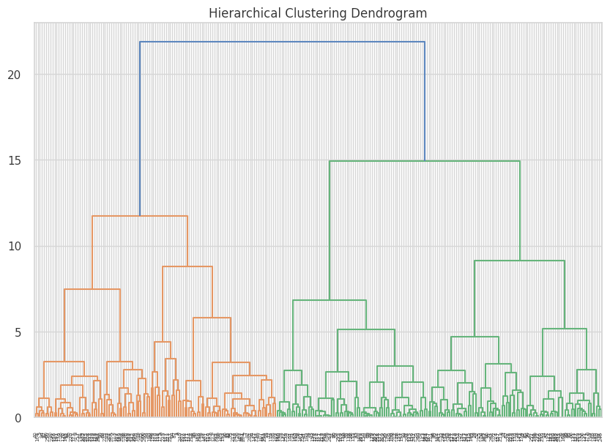
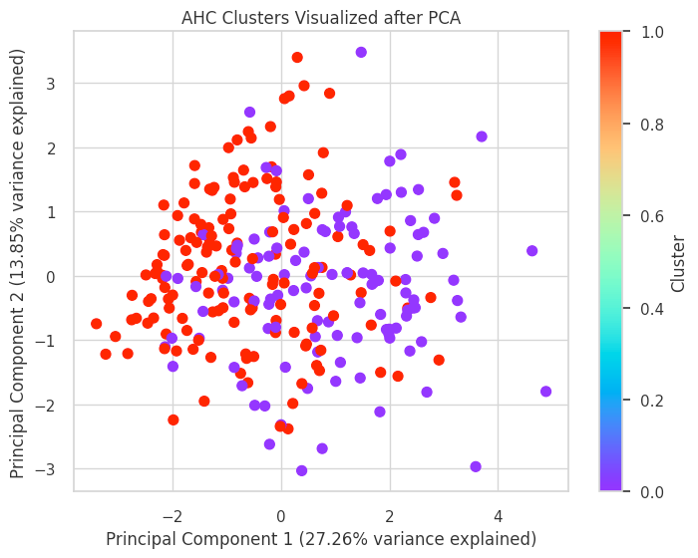
Hierachical Clustering
We use Gower distance instead of Euclidean (default) - deals with mixed data well and has a higher silhouette score (0.31 as compared to 0.15)
We cut the dendogram at t=18 -> 2 clusters and visulaize the data in 2D
Clusters are less well-defined by components as compared to K-means
Silhouette score of about 0.31 with 2 classes (better than K-means)

Slide 17
Unsupervised Learning Conclusion
Silhouette Scores
With 2 clusters, silhouette scores are:
Kmeans - ~0.18
Kmeans with PCA - ~ 0.22
Hierachical - ~ 0.15
Hierachical with Gower’s - ~0.31
Best Model = Hierachical Clustering with Gower’s distance
Adjusted Rand Score
Comparison with the labelled data and the clusters created
Kmeans - ~0.33
Kmeans with PCA - ~ 0.32
Hierachical - ~ 0.27
Hierachical with Gower’s - ~0.25
Best Model =K-Means
Conclusion:
Clustering should probably not be used to perform classification. As seen in the PCA map of the data, the classes are not well defined visually in 2D and seem to overlap

